Slide 1
Menu for G10 students
Glinda, Sophie, Max, Alfred

Slide 2
Content
Introduction
Correlation
Menu
Nutrition
Food Choices
Cost and Profit

Slide 3
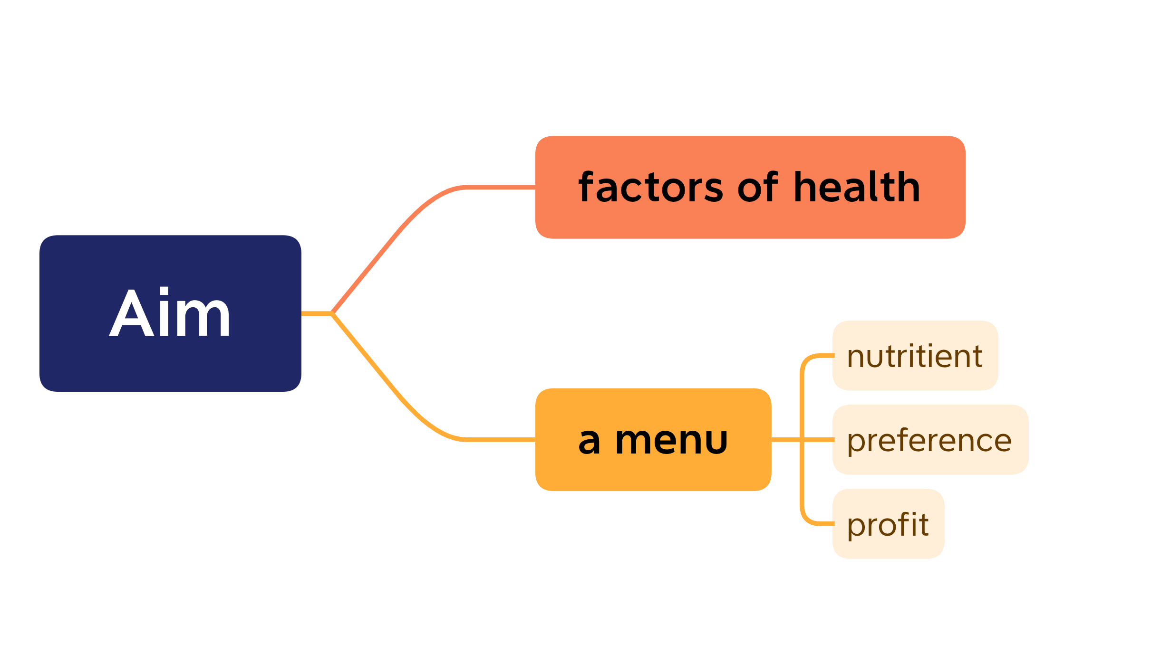
Introduction
Notes:
Our investigation has two aims: to find the factors affecting students’ health, and to create a comprehensive menu that provides adequate amount of nutrients for students, caters to their preferences and maximizes our profits

Slide 4
BMI
“The BMI correlates sufficiently well with direct measures of total body fat to support its use, on an anonymous basis, as a public health tool for monitoring progress in dealing with the obesity epidemic. “
However, the BMI is an imperfect proxy for obesity because there is much individual variability in the relationship between BMI and body fat, cardiovascular risk factors, and long-term health outcomes. ”
---Hall DMB, Cole TJ What use is the BMI? Archives of Disease in Childhood 2006;91:283-286.
Notes:
We use BMI as the index of health. BMI can't fully represent the health conditions of students. However, for this rather big-scale data collection, BMI is sufficient for representing the general trend

Slide 5
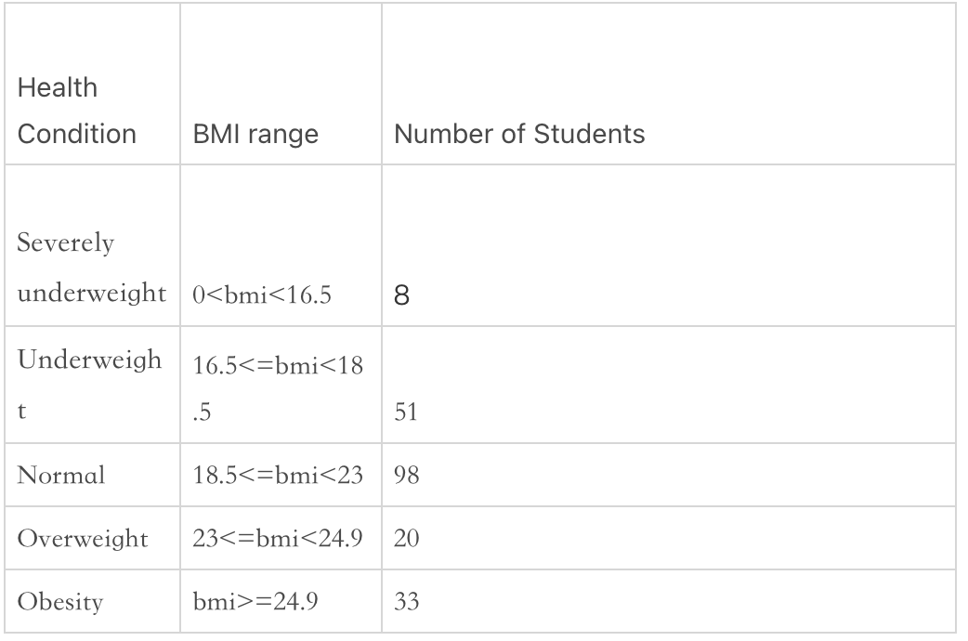
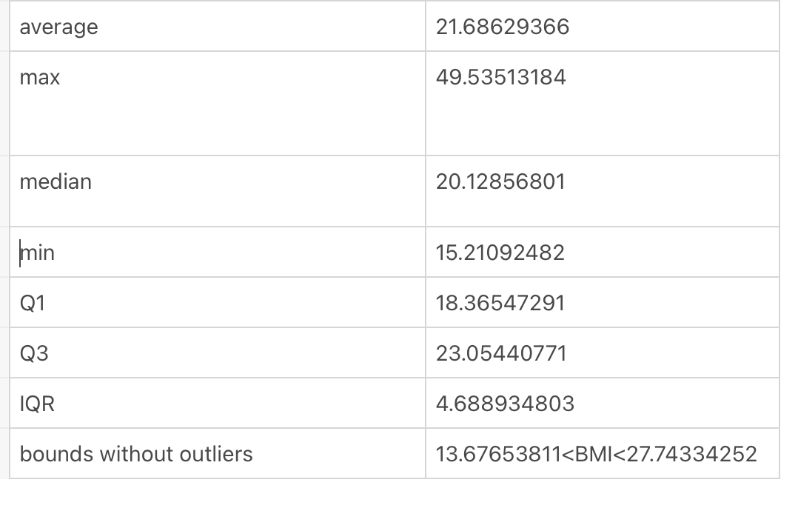
Overview

Slide 6
Flaws
“非常满意”？
“非常不满意？
Inequality Sign

Slide 7
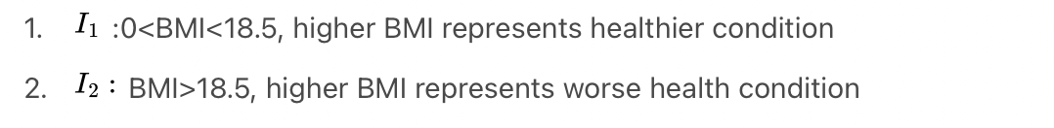
Correlation-Method
Statement of Data Used
BMI which exceeds boundary shouldn't be excluded
Manually fixed
Seperation of Interval

Slide 8
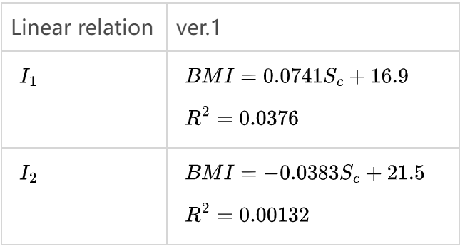
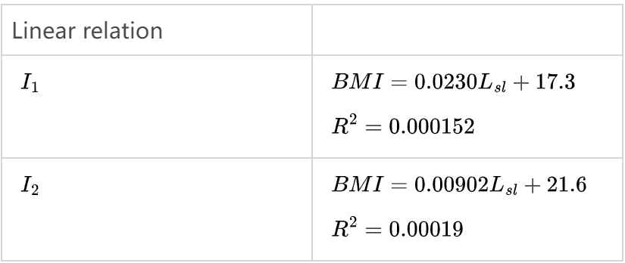
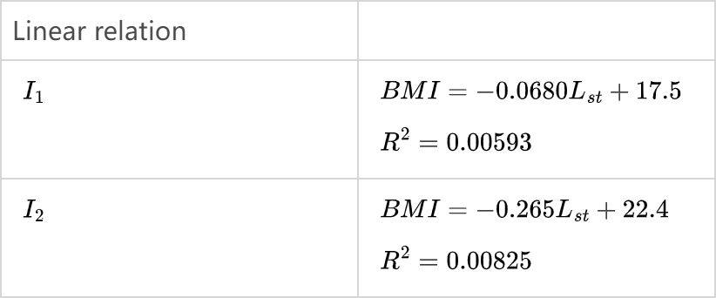
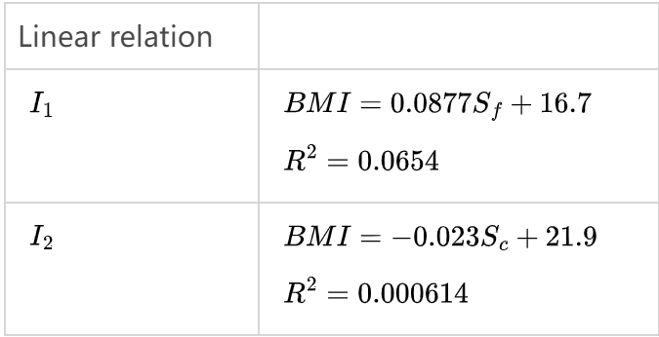
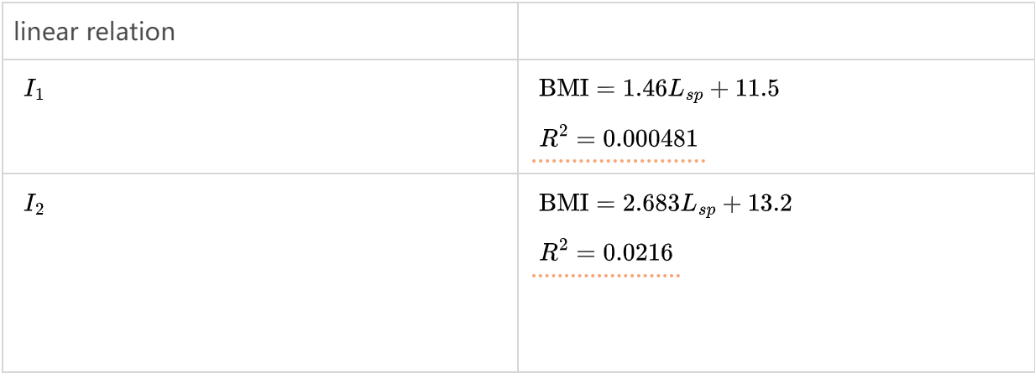
Correlations
sleeping
studying
School Life
Food
Sports

Slide 9
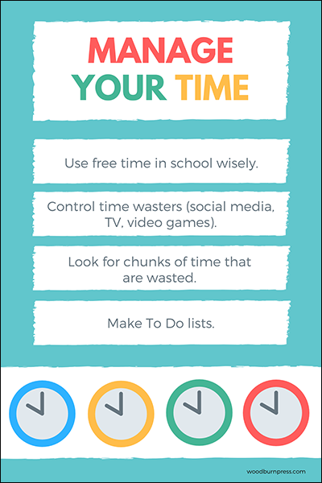


Tips
Physical Exercises
Manage Time
Enough Sleep

Slide 10
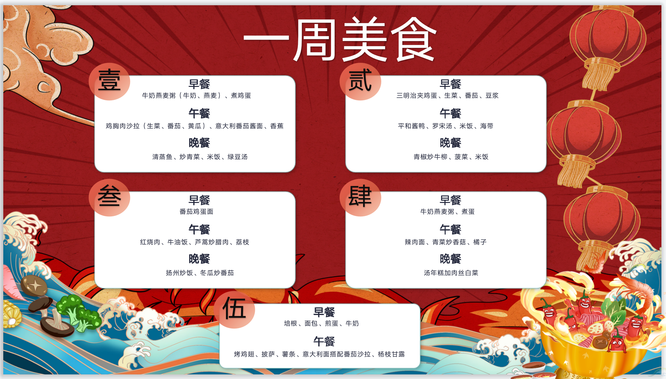

Slide 11
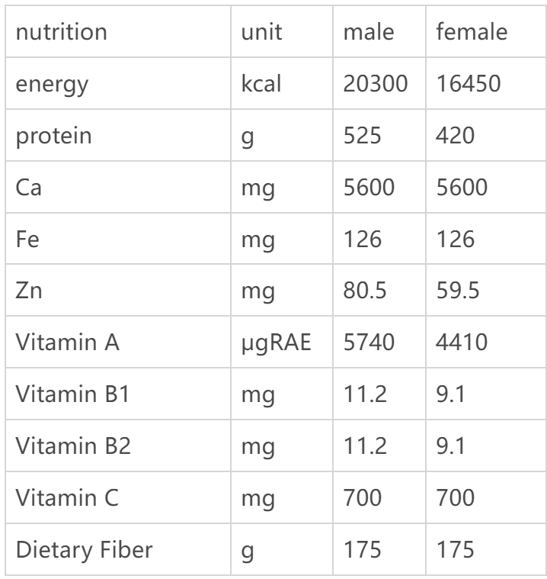
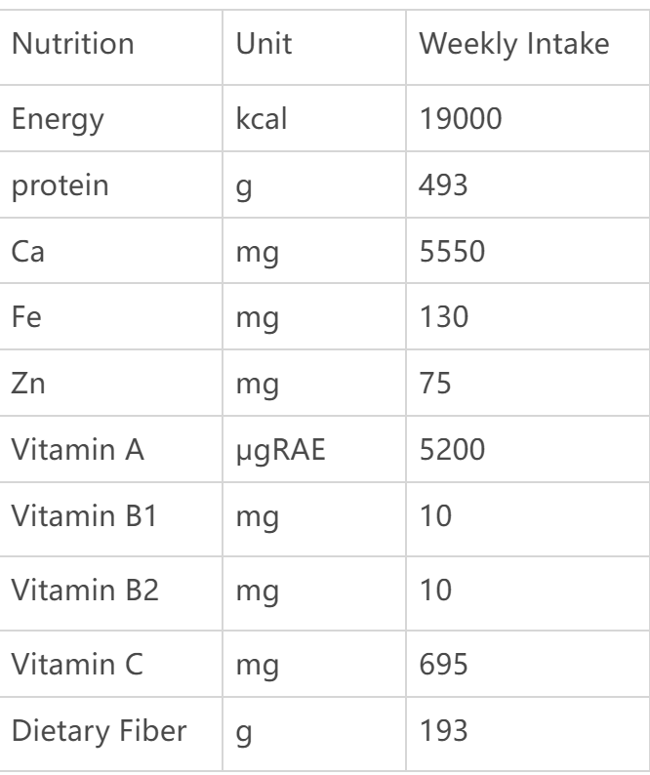
Nutrition Intake
Weekly Suggestion
Menu Designed
*souces:https://www.chinanutri.cn/fgbz/fgbzjszn/202103/P020210304358480794678.pdf
Notes:
On your left hand is a table of suggested nutrients issued by National Health and Family Planning Commission of the People’s Republic of China. On your right is the nutrients provided by our menu.

Slide 12

Frequency Analysis and Adaptations
Chicken Wings
Tomatoes
Spaghetti
Beef
Pizza
French Fries
Pinghe Roast Duck
Fried Egg

Slide 13
Cost and Profit-Cost for Raw Material
Milk (牛奶): 2 yuan
Oats (燕麦): 3 yuan
Egg (鸡蛋): 0.5 yuan
Chicken breast (鸡胸肉): 10 yuan
Lettuce (生菜): 2 yuan
Tomato (番茄): 1 yuan
Cucumber (黄瓜): 1 yuan
Italian tomato sauce (意大利番茄酱): 5 yuan
Banana (香蕉): 2 yuan
Steamed fish (清蒸鱼): 15 yuan
Stir-fried vegetables (炒青菜): 3 yuan
Rice (米饭): 1 yuan
Green beans (绿豆): 2 yuan
Sandwich bread (三明治面包): 5 yuan
Soy milk (豆浆): 4 yuan
Braised duck (平和酱鸭): 20 yuan
Russian-style soup (罗宋汤): 8 yuanx
Kelp (海带): 3 yuan
Green pepper (青椒): 2 yuan
Beef tenderloin (牛柳): 15 yuan
Spinach (菠菜): 3 yuan
Braised pork belly (红烧肉): 12 yuan
Butter rice (牛油饭): 5 yuan
Chrysanthemum greens (芦蒿): 3 yuan
Cured meat (腊肉): 5 yuan
Lychee (荔枝): 10 yuan
Yangzhou fried rice (扬州炒饭): 8 yuan
Shiitake mushroom (香菇): 5 yuan
Orange (橘子): 1 yuan
Bacon (培根): 8 yuan
Fried egg (煎蛋): 2 yuan
Grilled chicken wings (烤鸡翅): 15 yuan
Pizza (披萨): 25 yuan
French fries (薯条): 5 yuan
Spaghetti (意大利面): 8 yuan
Mango pomelo sago (杨枝甘露): 10 yuan
Winter melon (冬瓜): 2 yuan
Fried rice (炒饭米饭): 3 yuan
Stir-fried rice cakes (炒年糕): 6 yuan
Chinese cabbage (白菜): 2 yuan
Spicy meat noodles (辣肉面): 10 yuan

Slide 14
Cost and Profit-Weekly Cost For A Person
Monday: 37.5
Tuesday: 58.5
Wednesday: 50.0
Thursday: 26.5
Friday: 82.0
Weekly cost: 254.5

Slide 15
Cost and Profit-Total profit
Weekly profit per person =5×70-254.5=¥95.5
Weekly profit for the school =221×95.5=¥21,105.5

Slide 16
Thanks!

